Slide 1
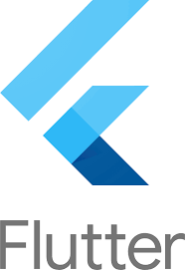
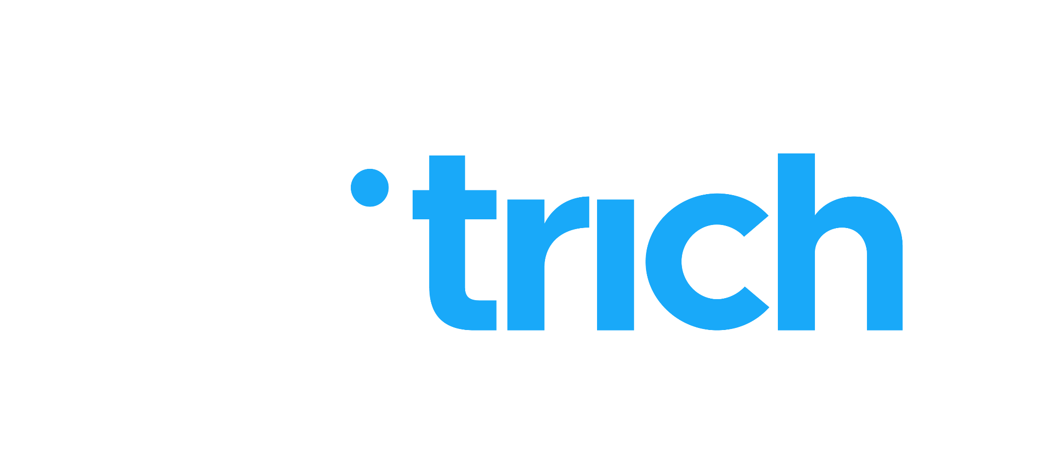
Welcome to Flutter: An Introduction
Module 1: Introduction to Flutter
Professional Flutter Developer
Notes:
Hello everyone, welcome to our session on "Introduction to Flutter.", In this Presentation we will delve into the world of Flutter.We will cover Flutter Framework, Key features of flutter, Essence of flutter, Flutter’s Role in Modern Development, Capabilities of Flutter and Setting the Stage for Flutter learning.

Slide 2
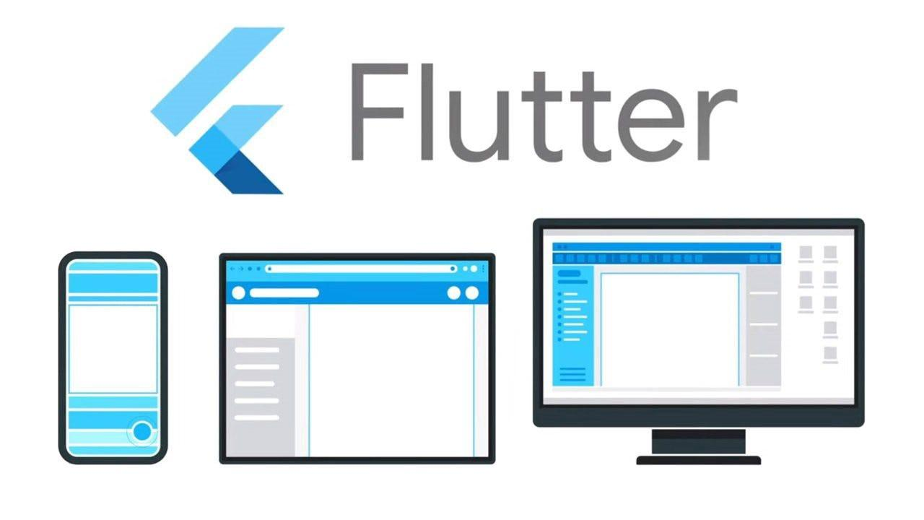
The Flutter Framework
Flutter: Google's UI toolkit for building beautiful, natively compiled applications.
Cross-platform capabilities: Develop for mobile, web, and desktop from a single codebase.
Scope of this chapter: Setting the stage for a deep dive into Flutter.
Notes:
Hello and welcome to the world of Flutter! Today, we embark on an exciting journey into one of the most innovative and forward-thinking frameworks in the world of application development.
Flutter, developed by Google, is not just another framework; it's a powerful UI toolkit that allows us to build visually stunning and natively compiled applications. What makes Flutter stand out is its ability to let us write a single codebase that runs on multiple platforms – including mobile, web, and desktop.
In this opening chapter, we're going to introduce you to the basics of Flutter. We'll explore what Flutter is, its key features, and why it's becoming a go-to choice for developers worldwide. This chapter is designed to provide a foundation that we'll build upon in the subsequent modules, where we'll delve into everything from Flutter's architecture to its advanced features.
So, let's get started on this journey together, and by the end of this bootcamp, you'll not only understand what makes Flutter special but also be equipped with the skills to build your own Flutter applications.

Slide 3
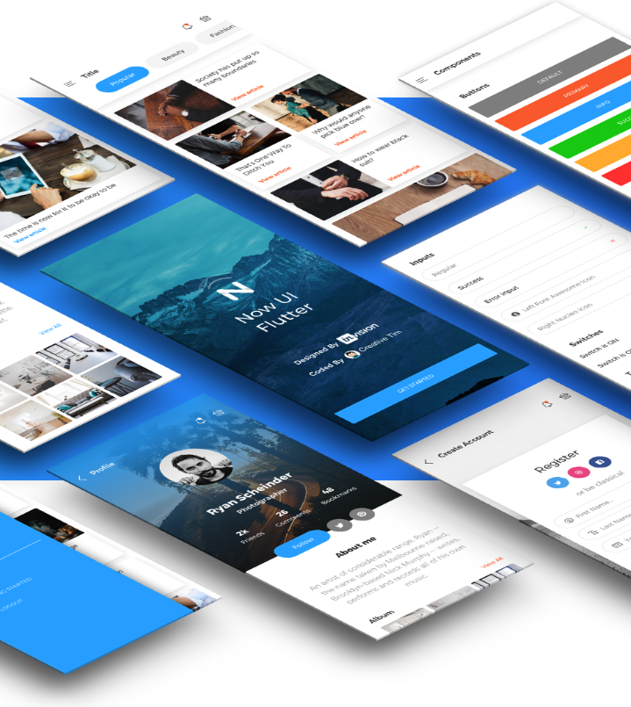
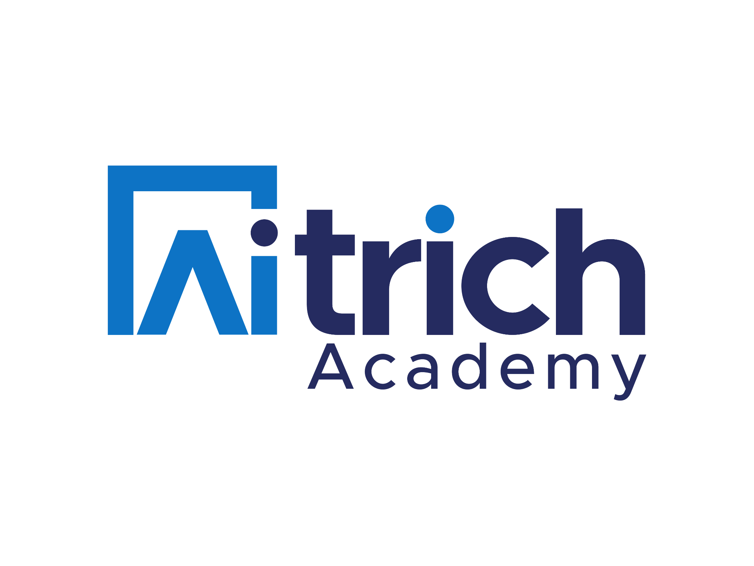
Flutter at a Glance
Flutter: A powerful UI toolkit for crafting high-quality interfaces on mobile, web, and desktop.
Key Features:
  Fast development
  Expressive and flexible UI
  Native performance.
Single Codebase: Write once, run everywhere philosophy.
Rich Widget Library: A comprehensive set of pre-designed and customizable widgets.
Notes:
Fast development: Flutter's "hot reload" feature lets you see code changes instantly without app restarts, speeding up your development cycle.
Expressive and flexible UI: Flutter uses widgets for everything, providing building blocks to create any UI you can imagine. It's flexible and allows for deep customization.
Native performance: Flutter compiles down to native code, offering smooth and fast performance on mobile, web, and desktop platforms.
Single codebase: Write your app's code once and deploy it across different platforms (Android, iOS, Web, Desktop) without major changes, saving time and effort.
Rich widget library: Flutter comes with a large collection of pre-built and customizable widgets for common UI elements like buttons, lists, inputs, animations, and more. This reduces development time and ensures consistency.

Slide 4
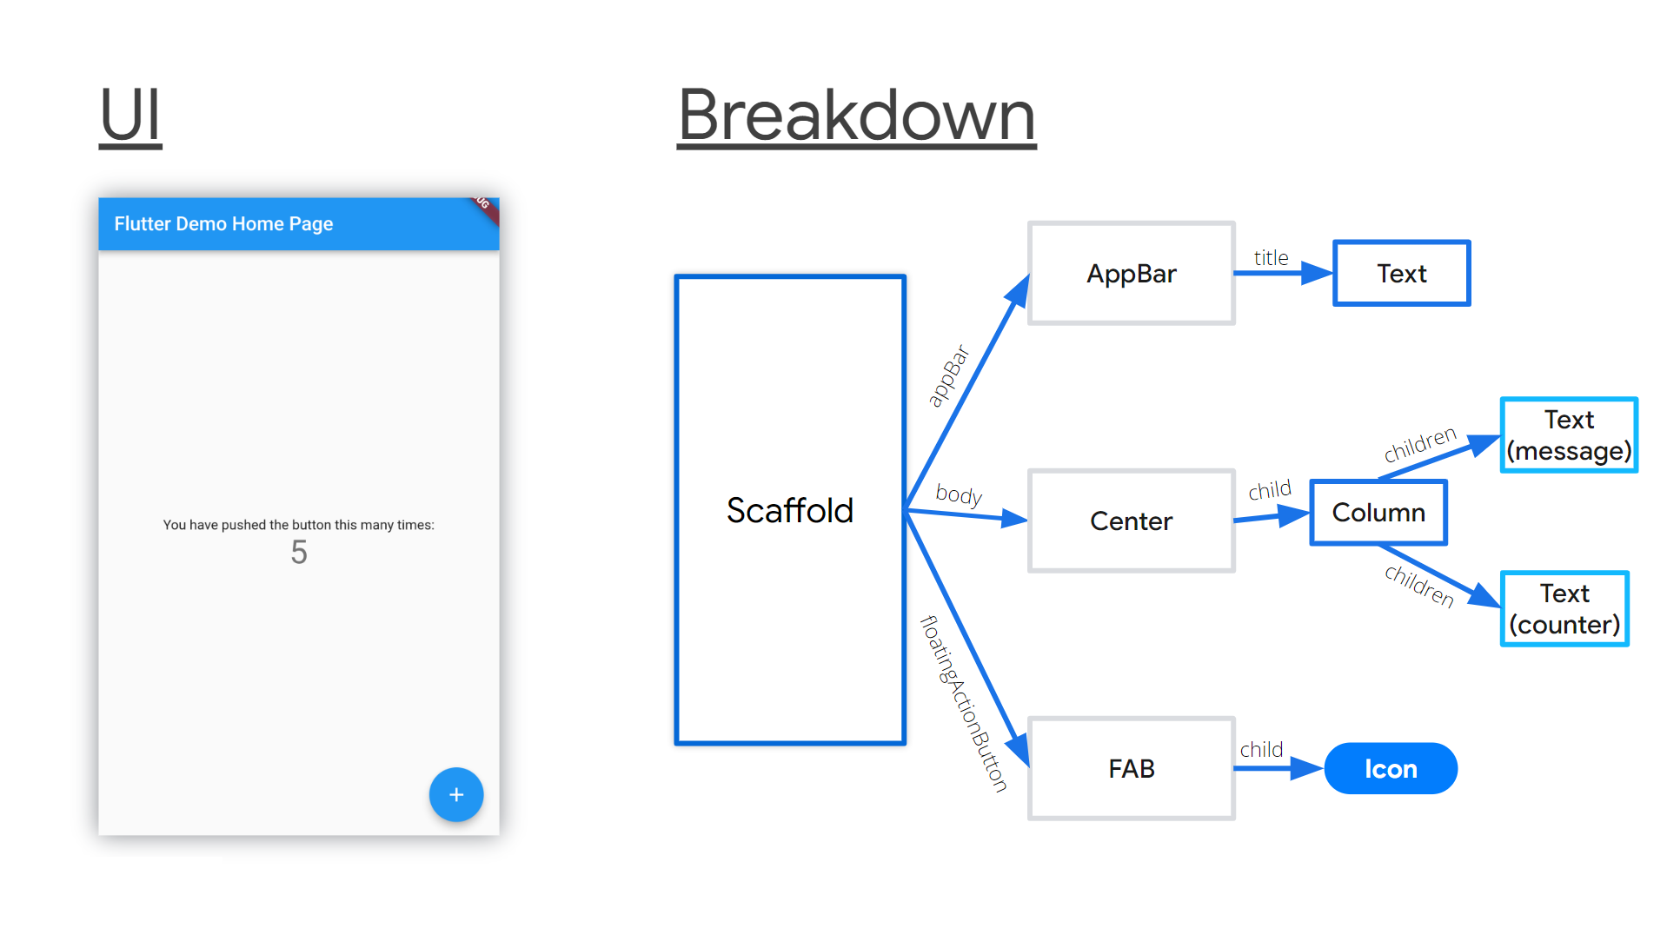
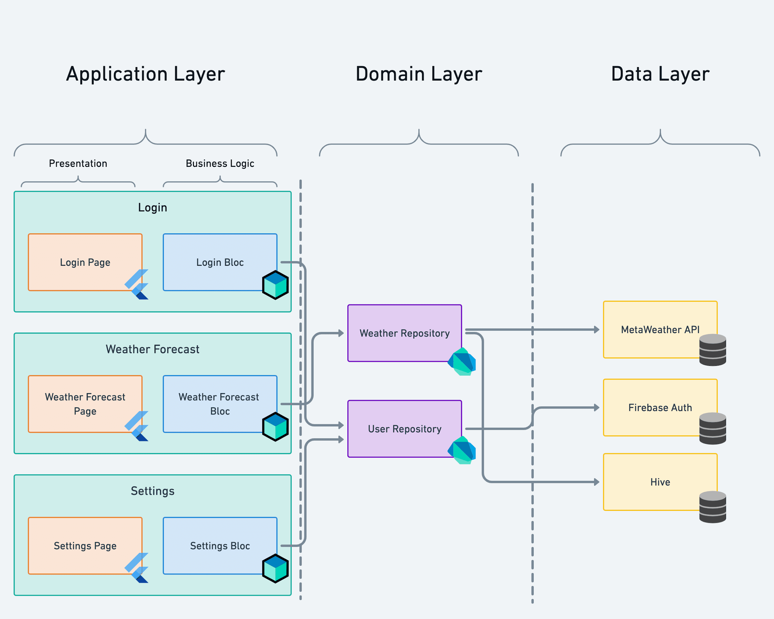
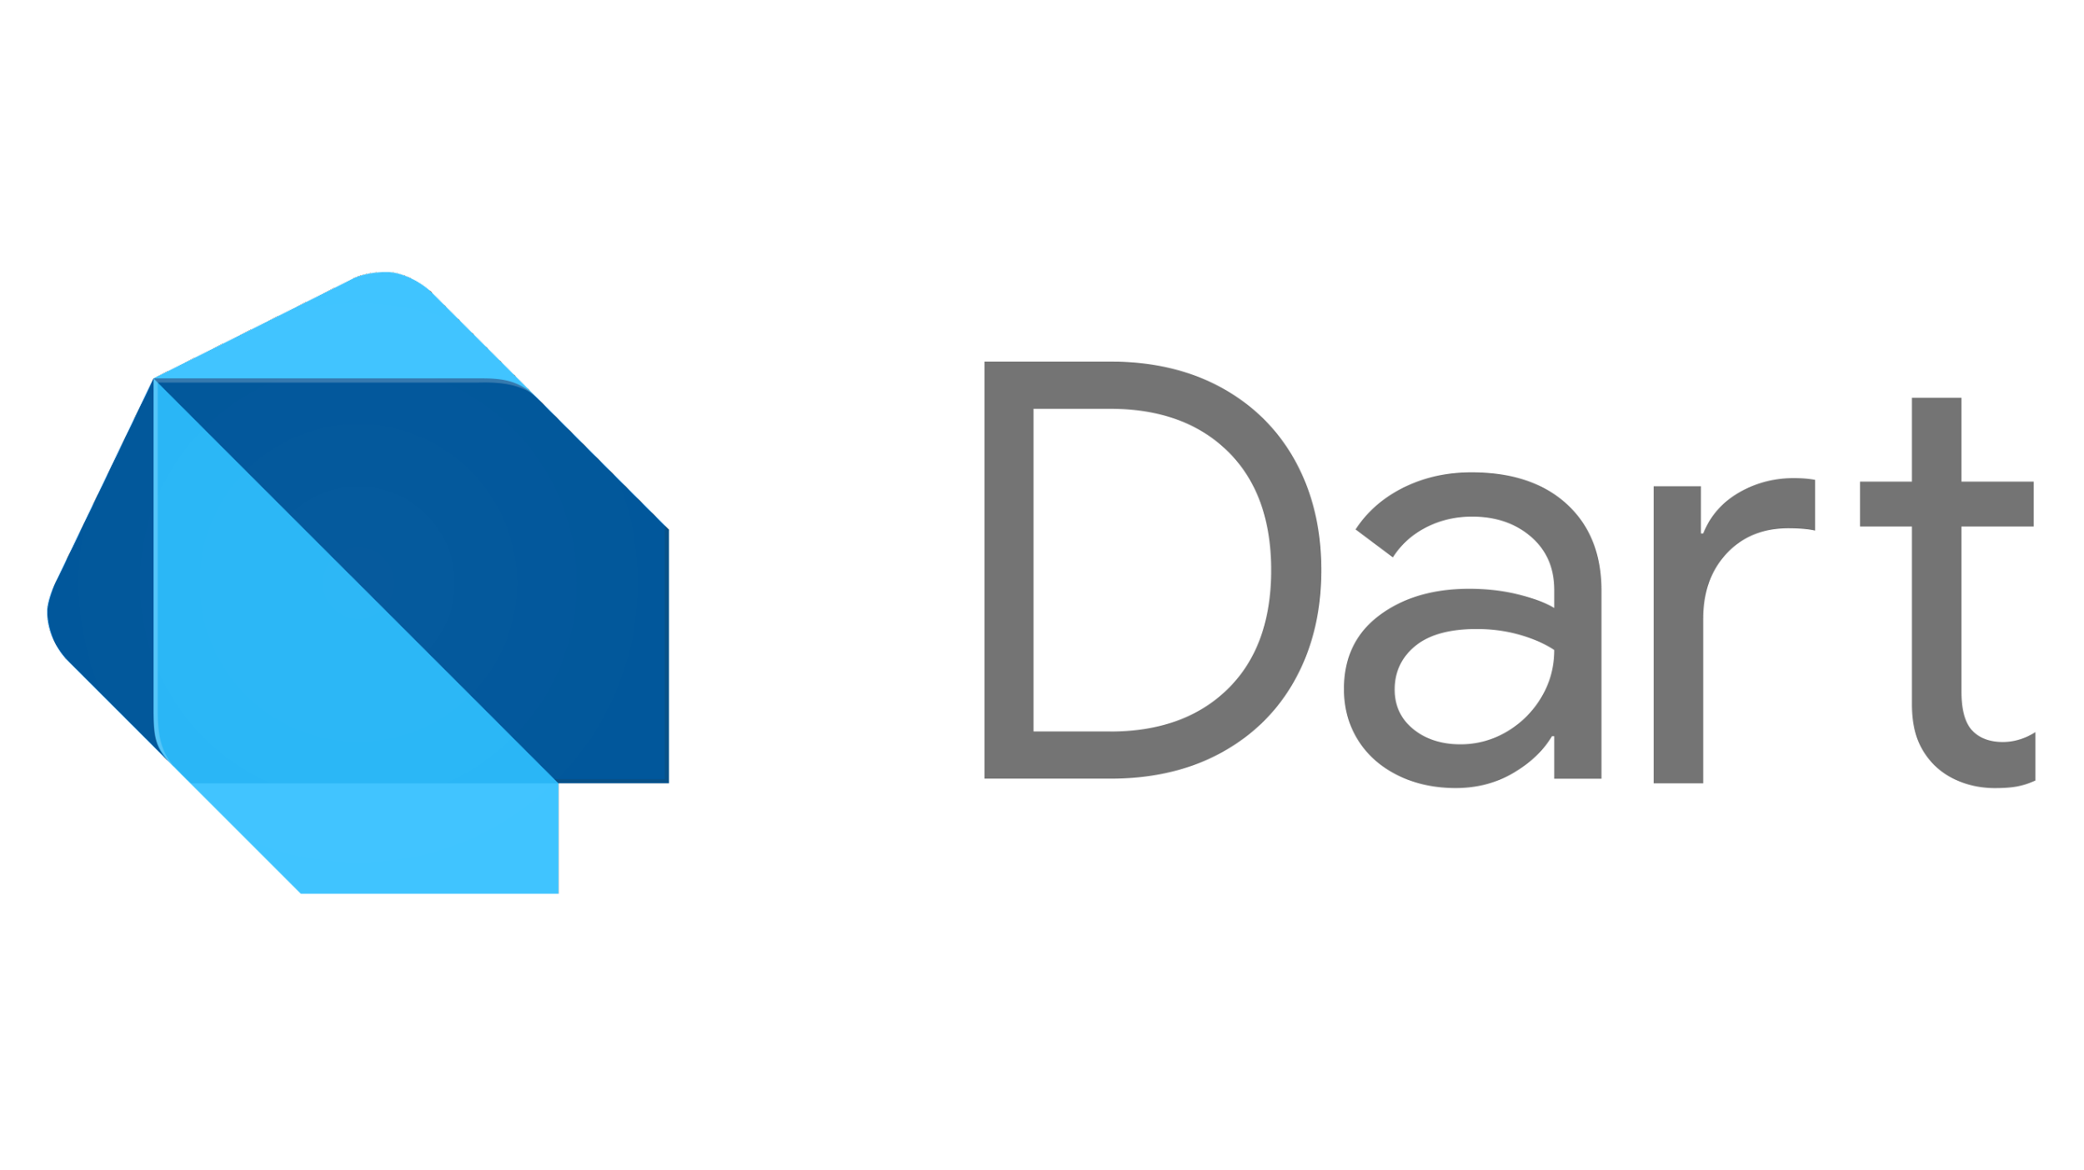
The Essence of Flutter
Flutter's Core Philosophy:
  Everything is a Widget: Flutter's fundamental building block.
Layered Architecture: Customizable and extensible at every level.
Dart Programming Language: Optimized for UI, fast on all platforms.
Focus on Beautiful UI: Exceptional visual details and smooth animations.
Notes:
Flutter's philosophy centers around the idea that everything in the UI is a widget, from a simple text to complex layouts. This approach simplifies the development process and offers immense flexibility in designing the interface.
The layered architecture of Flutter allows for extensive customization and extensibility. Developers can interact with any layer of the system, offering control over the look and feel of the application, down to the lowest level.
Dart, the programming language used in Flutter, is optimized for building UIs. It enables fast and fluid experiences on all platforms, ensuring that your application runs smoothly regardless of the device.
A significant focus of Flutter is on crafting beautiful user interfaces. It provides the tools and capabilities to create applications with exceptional visual details and smooth animations, making the user experience stand out.
In essence, Flutter is not just a framework; it's a complete ecosystem that empowers developers to build visually appealing and highly functional applications across platforms with ease and efficiency.

Slide 5

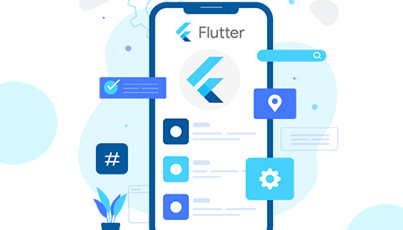
Flutter's Role in Modern Development
Rising Popularity: Rapidly growing user base and community.
Versatility: Suitable for a wide range of applications, from startups to enterprise solutions.
Innovation Driver: Pushing the boundaries of cross-platform development.
Cost-Effective: Reducing development time and resources.
Notes:
Flutter is rapidly gaining popularity in the tech world, with a growing user base and an active community. This surge in interest is a testament to its effectiveness and potential in modern app development.
Its versatility makes it a suitable choice for a wide range of applications. Whether it's a small startup project or a complex enterprise solution, Flutter provides the tools and capabilities to build high-quality applications.
As an innovation driver, Flutter is pushing the boundaries of what's possible in cross-platform development. It challenges the traditional norms and offers a fresh perspective on building apps that are both efficient and beautiful.
One of the key reasons Flutter is becoming a go-to choice for many developers is its cost-effectiveness. By reducing development time and resources needed to build cross-platform applications, it allows businesses to allocate their resources more efficiently.
In the current tech landscape, Flutter stands out as a framework that not only meets the demands of modern app development but also drives innovation and efficiency. It's a tool that aligns with the future of technology, making it an essential skill for developers looking to stay ahead in the industry.

Slide 6
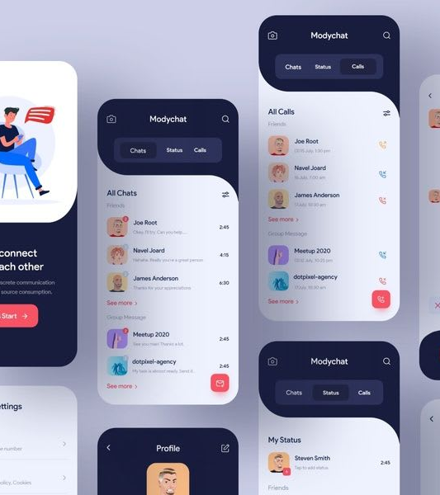
Capabilities - What Flutter Can Do
High-Quality Interfaces: Building visually appealing and responsive UIs.
Cross-Platform Development: Seamless experiences on iOS, Android, Web, and Desktop.
Rapid Development: Fast iteration with hot reload and a rich set of widgets.
Strong Community Support: Extensive resources, plugins, and packages available.
Notes:
Flutter is renowned for its ability to build high-quality interfaces. It provides a rich set of tools and widgets that enable developers to create visually appealing and responsive UIs, enhancing the overall user experience.
One of the most compelling features of Flutter is its cross-platform development capability. It allows for the creation of seamless experiences across iOS, Android, Web, and Desktop platforms. This means you can reach a wider audience without the need to maintain multiple codebases.
The framework is designed for rapid development. The hot reload feature is a game-changer, allowing developers to see the changes in real-time without restarting the app. This, combined with a comprehensive set of pre-designed widgets, significantly speeds up the development process.
Another strength of Flutter is the strong community support it enjoys. The ecosystem is rich with extensive resources, plugins, and packages, making it easier for developers to implement complex functionalities and stay updated with the latest trends.
In summary, Flutter's capabilities are vast and varied, making it an ideal choice for developers looking to build modern, high-quality applications efficiently. The framework not only simplifies the development process but also opens up new possibilities in app design and functionality.

Slide 7

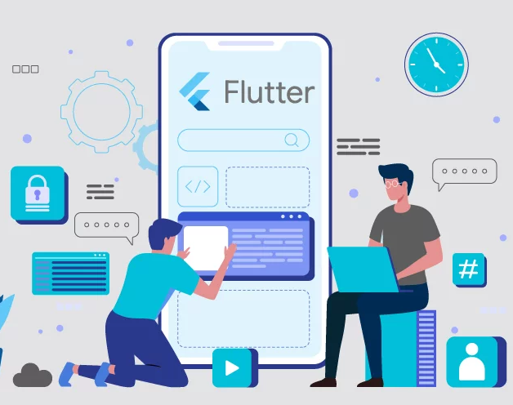
Setting the Stage for Flutter Learning
What to Expect in the Upcoming Modules
Comprehensive Coverage: From basics to advanced topics in Flutter.
Hands-On Approach: Practical examples and real-world applications.
Deep Dive into Dart: Understanding the language behind Flutter.
Focus on Best Practices: Writing efficient, maintainable, and scalable code.
Notes:
As we progress through this bootcamp, you can expect a comprehensive coverage of Flutter. We'll start from the basics, ensuring a solid foundation, and gradually move to more advanced topics. This structured approach is designed to build your skills step by step, ensuring a deep understanding of Flutter and its capabilities.
We believe in a hands-on approach to learning. Throughout the course, we'll be working on practical examples and real-world applications. This method will not only help you grasp the concepts better but also give you a taste of what it's like to develop Flutter apps in a real-world setting.
A significant part of our journey will be a deep dive into Dart, the programming language used in Flutter. Understanding Dart is crucial as it's the backbone of Flutter development. We'll explore its syntax, features, and how it integrates seamlessly with Flutter to create powerful applications.
Lastly, a key focus of our learning will be on best practices. We'll emphasize writing efficient, maintainable, and scalable code. This is essential for professional development, as it not only improves the quality of your applications but also makes them easier to manage and evolve over time.
In summary, this chapter sets the stage for an exciting and comprehensive learning journey. We'll cover everything you need to know to become proficient in Flutter, from the ground up, and equip you with the skills to build high-quality, cross-platform applications.

Slide 8
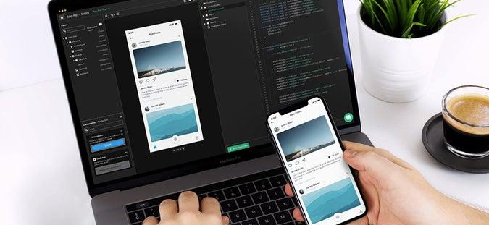

Your Flutter Journey
Beginning a Transformative Journey: Embrace the learning curve.
The Thrill of Learning Flutter: Discovering new possibilities in app development.
Anticipating the Road Ahead: A glimpse into the diverse topics we'll explore.
Building a Community: Engaging with fellow learners and experts.
Notes:
As we embark on this journey together, it's important to embrace the learning curve that comes with mastering a new technology like Flutter. This journey might be challenging at times, but it's also incredibly rewarding. You're not just learning a new framework; you're acquiring skills that will significantly enhance your capabilities as a developer.
The thrill of learning Flutter lies in discovering the vast possibilities it opens up in app development. Whether it's creating visually stunning UIs or building applications for multiple platforms with ease, Flutter offers a world of opportunities to explore and master.
Throughout this bootcamp, we'll dive into a wide range of topics, from the basics of Dart programming to advanced Flutter features. We'll cover state management, animations, backend integration, and much more. This comprehensive approach ensures that by the end of this course, you'll have a well-rounded understanding of Flutter and its ecosystem.
Finally, remember that you're part of a community. Engaging with fellow learners and experts throughout this journey will enrich your learning experience. Share your challenges, celebrate your successes, and learn from each other. This collaborative environment will not only help you grow as a developer but also make the journey more enjoyable.
So, let's get started with enthusiasm and an open mind. The world of Flutter awaits, and I can't wait to see the amazing applications you'll create!

